Slide 1
Towards improved glucose control in critically ill patients
Navid Soltani, M.D
Resident Physician in Anesthesia & Intensive Care
Perioperative Medicine & Intensive Care, Karolinska University Hospital Solna
Supervisor: Johan Mårtensson, M.D, Assoc. Professor
Co-supervisors: Ragnar Thobaben, M.Sc, Assoc. Professor
Henrike Häbel, M.Sc, PhD
David Nelson, M.D, PhD
Notes:
Good morning!
My name is Navid Soltani, I am a resident physician in anesthesia and intensive care at the Karolinska University Hospital in Solna
I’m grateful to be able to present my proposed doctoral project here today.
The title of both my project and presentation is ”Towards improved glucose control in critically ill patients”
And we’ll start off with a general background regarding the problem

Slide 2
Background
Stress-hyperglycemia, common in critical illness, is associated with increased mortality in ICU-patients. Consequently, the majority of ICU-patients receive insulin to control blood glucose.
Predicting the response to insulin in these patients is difficult, and the response is often dynamic during the period of critical illness, owing to inflammatory changes and drugs administered, such as catecholamines and glucocorticoids.
Rapid changes in blood glucose levels are in turn also associated with increased mortality, and severe hypoglycemia is a lethal complication if not immediately detected and treated.
Notes:
Stress-hyperglycemia is very common in patients requiring intensive care. Not only do the acute stress responses of critical illness, such as inflammation, and the release catecholamines and high spikes of glucocorticoids raise blood sugar, so do the many drugs we administer.
Hyperglycemia is in turn is associated with increased mortality in intensive care patients.
And in turn, a majority of ICU patients receive insulin to control blood glucose.
If we Zoom-out for a second to an ordinary diabetic population, not requiring hospital care, the blood-glucose reducing effect of insulin is individual. Some can make way with very few units, and some need incredibly large doses to achieve blood glucose control.
If we Zoom back in to patients requiring Intensive care, it turns out we’re in a different ballpark completely. Because of everything that’s going on with the critically ill patient, predicting the response to a “unit of insulin” is difficult, and becomes more of a trial-and-error exercise which takes valuable time. Additionally, the response is dynamic over the ICU duration, as the critical situation stabilizes, making the difficulty with prediction an particularly enduring problem, as it increases the risk for overshooting with the insulin, causing hypoglycemia, which in turn can be a lethal and/or morbidity associated complication
1. Whitcomb BW, Pradhan EK, Pittas AG, Roghmann M-C, Perencevich EN. Impact of admission hyperglycemia on hospital mortality in various intensive care unit populations. Crit Care Med. december 2005;33(12):2772–7.
2. Hanna M, Balintescu A, Glassford N, Lipcsey M, Eastwood G, Oldner A, m.fl. Glycemic lability index and mortality in critically ill patients-A multicenter cohort study. Acta Anaesthesiol Scand. oktober 2021;65(9):1267–75.

Slide 3
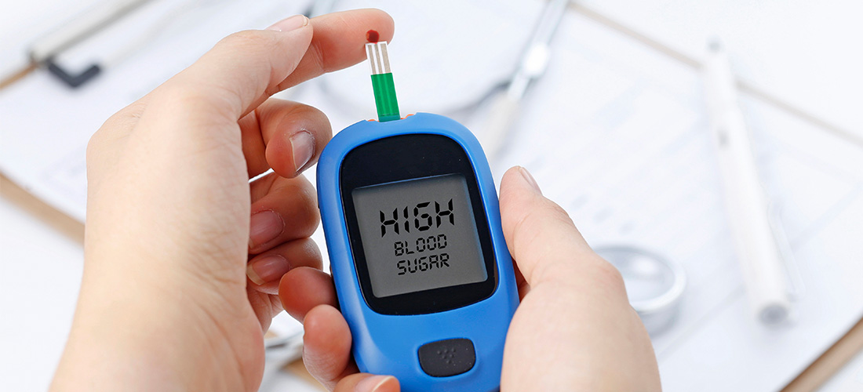
The Overarching Goal
Gathering knowledge that enables the development of novel decision systems that suggests changes in insulin administration to support personalized glucose control in the ICU, which will be important tools to improve the prevention of glucose fluctuations and hypoglycemia.
Achieving this has the potential to attenuate complications associated with glucose fluctuations and hypoglycemia in critically ill patients.

Slide 4
Specific Aims
The overall aim is to use a data-driven approach to reduce glucose fluctuations and hypoglycemia in critically ill patients by identifying factors that affect these variables.
Specifically, I want to:
Assess insulin-sensitivity in ICU patients with and those without COVID-19 using electronic health care data (study 1)
Assess the influence of various patient-related, illness-related, and treatment-related factors on insulin-sensitivity in ICU patients by applying traditional statistical methods (study 2) and machine learning methods (study 3) on electronic health care data.
Identify factors contributing to glucose fluctuations and hypoglycemia in the ICU by applying machine learning methods on electronic health care data (study 4)

Slide 5
Population & Data Sources
Population
This project will include all adult patients admitted to ICU at the Karolinska University Hospital since January 1, 2010.
Data sources
Clinisoft warehouse (CCC)
Karolinska internal data warehouse (KARDA)
Swedish Intensive Care Registry (SIR)
National Diabetes Registry (NDR)
Notes:
Clinisoft warehouse (CCC)
Clinisoft (Centricity™ Critical Care, GE Healthcare) is an electronic patient data management system (PDMS) used in all Karolinska ICUs since 2009. The system records high-resolution data from monitors, drug and fluid infusion pumps, mechanical ventilators, and dialysis machines and biochemical data from blood gas analyzers and from the Karolinska University Laboratory.
Karolinska internal data warehouse (KARDA)
KARDA mainly contains data from the electronic medical record (EMR) system Take Care (CompuGroup Medical, Koblenz, Germany). The system includes patient-specific data from hospitalization to discharge including information on comorbidities (coded according to International Classification of Diseases, 10th Revision, Swedish Edition [ICD-10-SE]), drug administration (coded according to the Anatomic Therapeutic Chemical [ATC] classification system), clinical chemistry and microbiology data. The system also collects information on mortality (including date of death) via the Swedish Cause of Death Registry.
Swedish Intensive Care Registry (SIR)
The Swedish Intensive Care Registry (SIR) collects individual patient data from all 83 ICUs in Sweden since 2001. The SIR collects information on ICU admission and discharge date and time, baseline patient characteristics, variables included in the Simplified Acute Physiology Score (SAPS) 3 model and ICU treatment variables.
National Diabetes Registry (NDR)
The National Diabetes Register, initiated in 1996, includes information on risk factors, complications of diabetes, and medications in adult patients. Each patient provides informed consent (verbal or written) for inclusion in the register, and more than 90% of all persons with type 2 diabetes in Sweden are included.

Slide 6
Planned studies

Slide 7
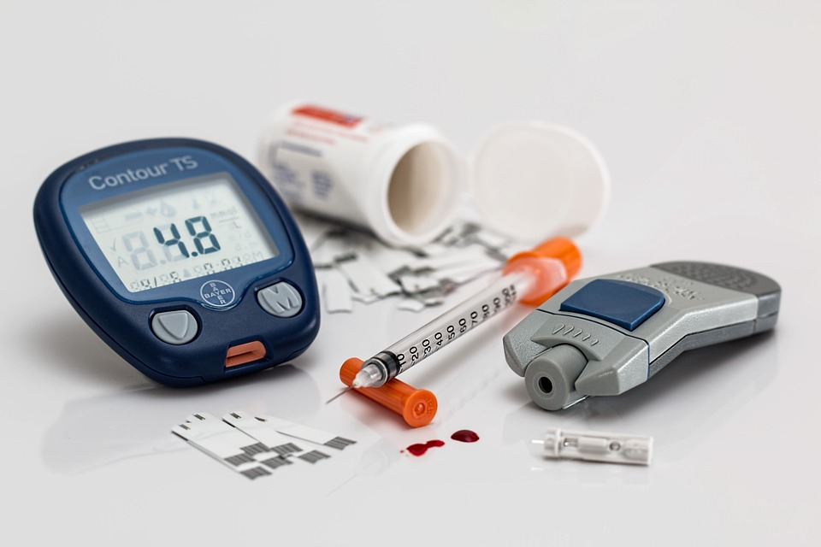
Study 1
Insulin sensitivity in critical COVID-19 patients vs general ICU patients
Insulin to Carbohydrate (I:C) ratio (or insulin requirements in units) as a proxy for insulin sensitivity. The I:C ratio is calculated for each day by dividing the total amount of insulin (in units) delivered that day with the total amount of enteral and parenteral carbohydrates (in grams) given during the same day.
Retrospective observational study comparing roughly 360 COVID-19 patients and an existing cohort of approximately 1000 ”general” ICU patients.
Aim of studying the differences in insulin sensitivity between the COVID-19 and the general ICU patients. The models will be adjusted for potential confounders such as age, sex, diabetes diagnosis, illness severity, and corticosteroid administration.

Slide 8
Daily insulin requirement during the first 14 days in ICU in non-covid patients (red boxes) and covid-19 patients (green boxes) stratified by diabetes diagnosis
Notes:
Daily insulin requirement during the first 14 days in ICU in non-covid patients (red boxes) and covid-19 patients (green boxes) stratified by Covid-19 diagnosis

Slide 9
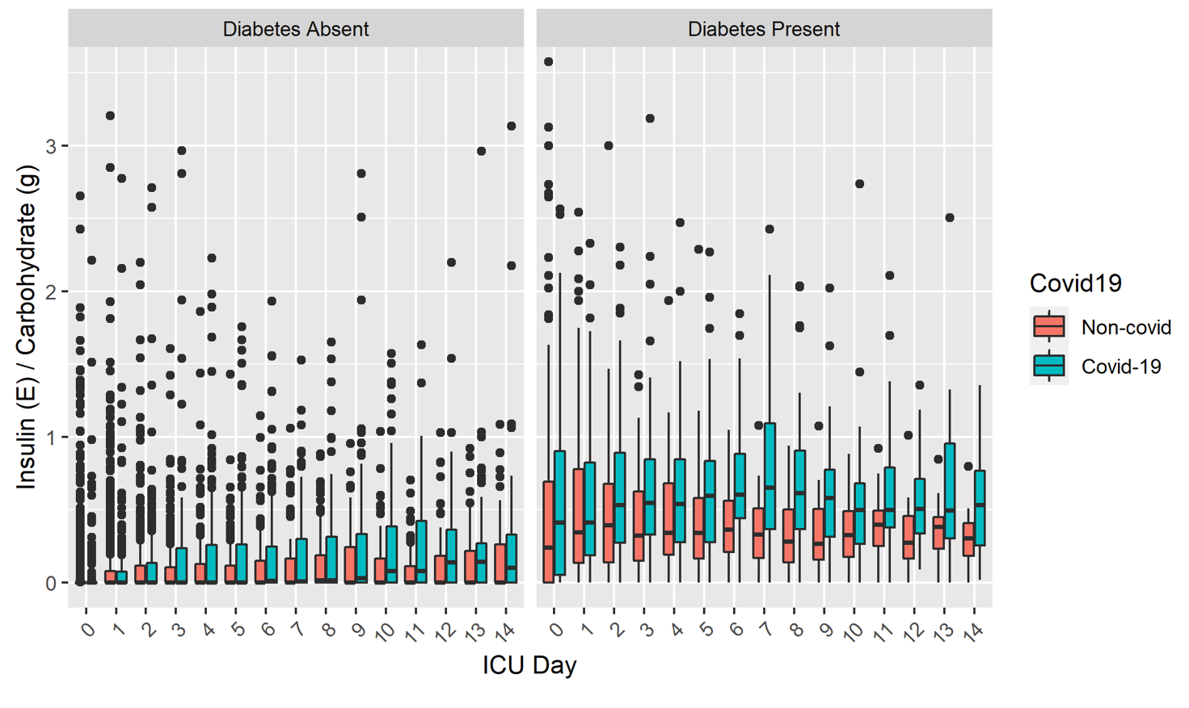
Daily insulin to carbohydrate (I:C) ratios during the first 14 days in ICU in non-covid patients (red boxes) and covid-19 patients (green boxes) without diabetes (left panel) and with diabetes (right panel).
Notes:
Daily insulin to carbohydrate (I:C) ratios during the first 14 days in ICU in non-covid patients (red boxes) and covid-19 patients (green boxes) without diabetes (left panel) and with diabetes (right panel).

Slide 10
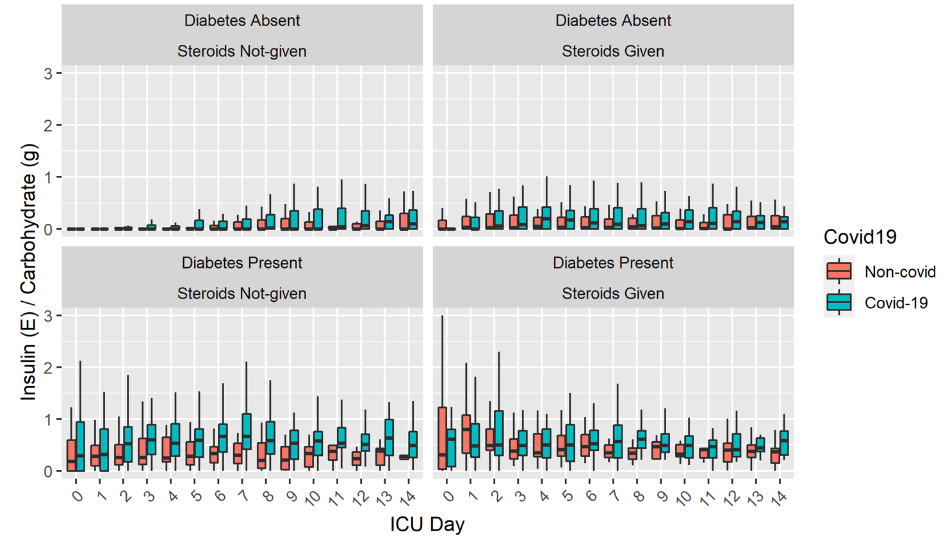
Daily insulin to carbohydrate (I:C) ratios during the first 14 days in ICU in non-covid patients (red boxes) and covid-19 patients (green boxes) stratified by the presence of diabetes and exposure to corticosteroids.
Notes:
Daily insulin to carbohydrate (I:C) ratios during the first 14 days in ICU in non-covid patients (red boxes) and covid-19 patients (green boxes) stratified by the presence of diabetes and exposure to corticosteroids.

Slide 11
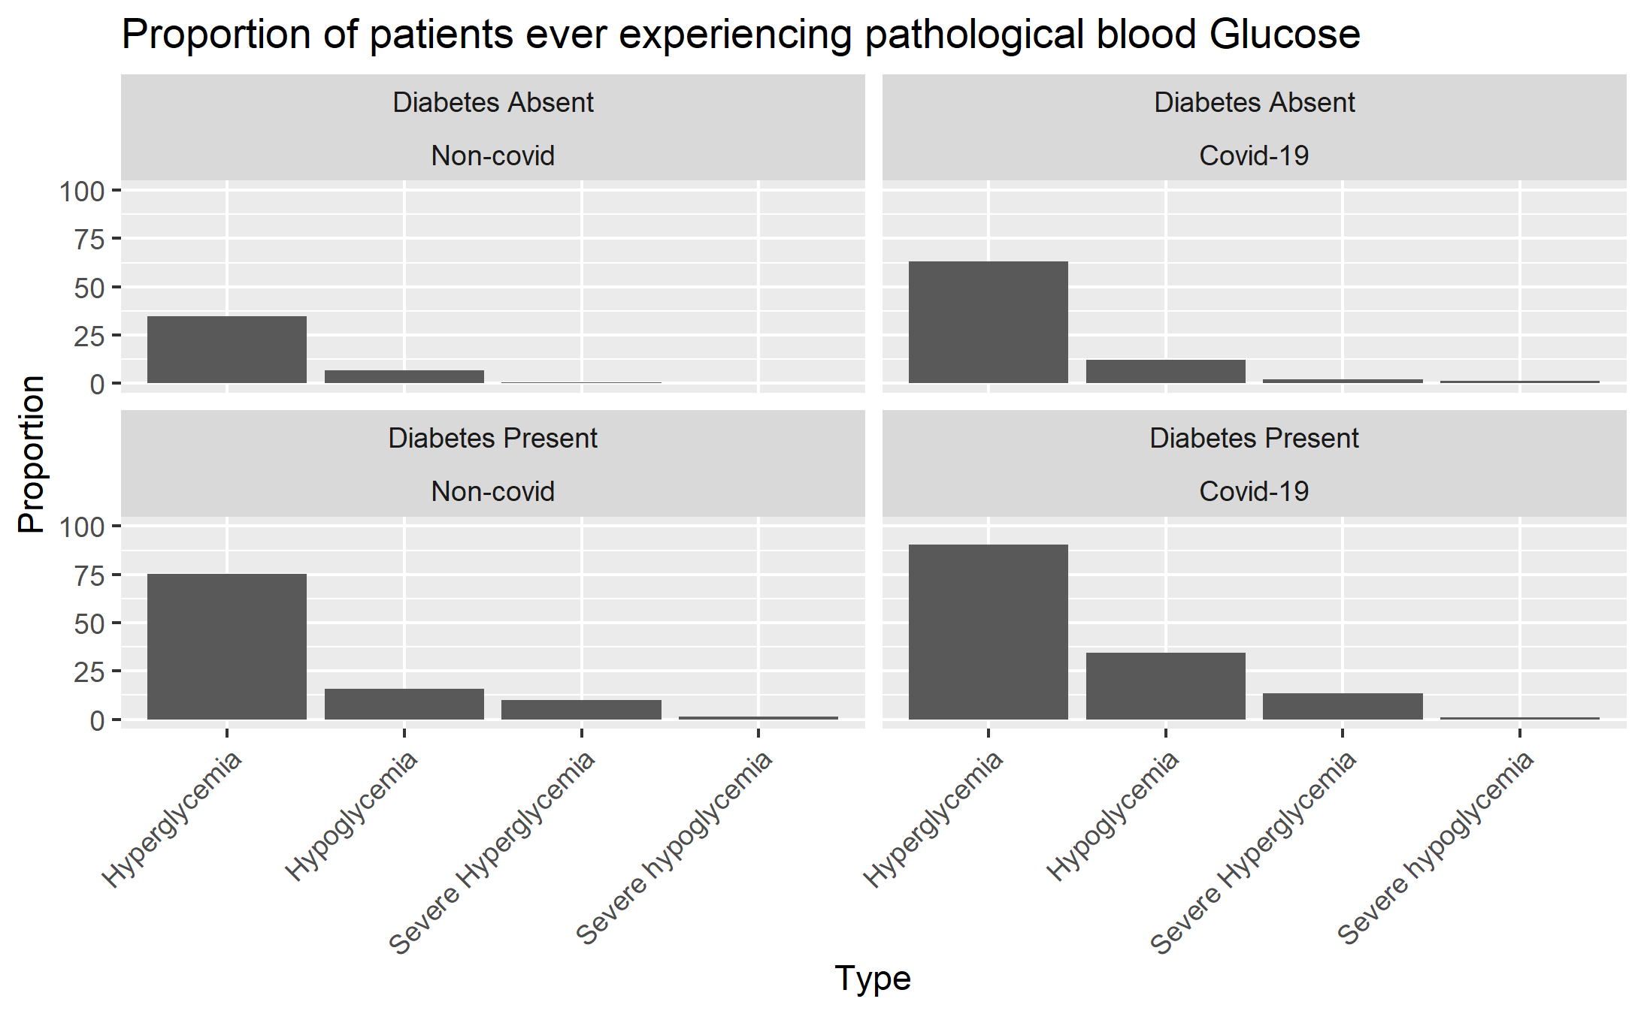
Notes:
A small illustration of problems better decisison systems could improve upon
(Value <= 2.2) ~ "SEVERE HYPOGLYCEMIA",
(Value >2.2 & Value <= 3.9) ~ "HYPOGLYCEMIA",
(Value >= 4 & Value <= 11.1) ~ "NORMOGLYCEMIA",
(Value >11.1 & Value <= 20) ~ "HYPERGLYCEMIA",
(Value >20) ~ "SEVERE HYPERGLYCEMIA")
)

Slide 12
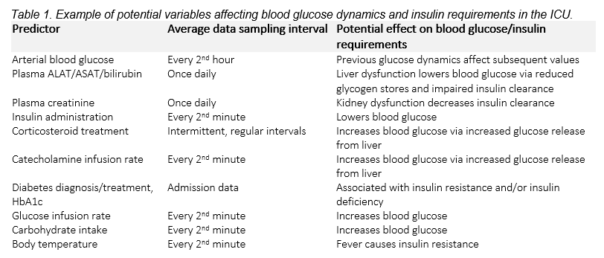
Study 2
Quantifying factors influencing insulin sensitivity in critically ill patients
Retrospective observational study including all consecutive adult (≥18 years old) patients admitted to Karolinska ICU since 2010. The primary outcome variable, insulin sensitivity, is defined as in Study 1.
Notes:
Generalized linear mixed effects models including a random intercept and slope will be used to identify independent predictor variables and to quantify their effect on insulin sensitivity.

Slide 13
Study 3
Using machine learning to identify factors that influence insulin sensitivity dynamics in critically ill patients
Population as study 2 and same definition of insulin sensitivity as study 1
In the first step, I will select exposure variables with a plausible effect on insulin sensitivity based on the insights gained in study 2. Additional variables will then be added to identify previously unknown predictors and to facilitate mechanistic thinking using machine learning models that have high interpretability (e.g. regression trees).
I aim to employ techniques such as clustering, as well as related ML techniques to handle time series data, with the purpose of identifying previously unidentified variables and quantify their effects on insulin sensitivity.
Notes:
Finally, to achieve uncertainty estimation, I will investigate the integration of evidential machine learning techniques. I will use relevant metrics such as the (adjusted) R-squared value and mean-squared error for regression problems. The results of this study will then be benchmarked to the results in study 2.

Slide 14
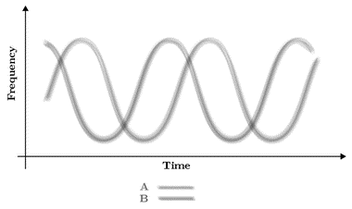
Study 4
Factors contributing to glucose fluctuation and hypoglycemia in intensive care by using machine learning methods
Population as study 2 and same definition of insulin sensitivity as study 1
This study will employ machine learning models similarly to study 3 in order to determine factors that affect glucose variability over time and hypoglycemia in the intensive care setting. Data will be prepared similarly to study 3, after which representation learning techniques will be employed for feature extraction and supervised learning techniques for prediction and classification.
We will focus on models with high interpretability (e.g., regression and classification trees) but will also consider hidden Markov models and recurrent and gated neural network models to handle time series data.
Notes:
This study will employ machine learning models similarly to study 3 in order to determine factors that affect glucose variability over time and hypoglycemia in the intensive care setting. Instead of I:E ratio, the focus are variables pertaining to glucose fluctuation such as: Glycemic lability, Time-Weighted Level, Hypoglycemia, Time in Target range

Slide 15
Supervision
Principal supervisor:
Johan Mårtensson
M.D, Associate professor, Senior Consultant Intensivist, Head of the Clinical Research Unit PMI
Co-supervisors:
Ragnar Thobaben
M.Sc, Associate Professor KTH
Henrike Häbel
M.Sc, PhD, Statistician
David Nelson
M.D, PhD, Senior Consultant Neurointensivist
Notes:
I'm very pleased to have an excellent research group by my side
My principal supervisor is Johan Mårtensson, associate professor, consultant intensivist, head of the clinical research unit at our department.
And my co-supervisors are:
Ragnar Thobaben, associate professor at the Royal Institute of Technology in Stockholm, with a broad knowledge of machine learning, artifical intelligence, programming and handling big data sets.
Henrike Häbel - expert knowledge of mathematics, statistics and epidemiology
David Nelson - expert knowledge of intensive care, epidemiology, machine learning and neuronal networks

Slide 16
Timeplan
80% PhD studies from spring 2022
Combined with clinical work
Half-time control spring 2025
Dissertation spring 2027
ALF

Slide 17
Courses and credit awarding elements
General science knowledge/courses
Research school for clinicians in epidemiology (30 HEC)
Quality Assurance of Clinical Research/GCP (1,5 HEC)
AI (2+6 HEC)
Other credit awarding elements
Journal clubs and seminars (4 HEC)
Presentation at international conferences (3 HEC)
Total 46,5 HEC
Notes:
I will of course attend the compulsory introduction.
I will also participate in recurrent journal clubs at the department and plan to present my research at international conferences.

Slide 18
Thank you!

Slide 19
Glycemic lability – Study 1

Slide 20
Time Weighted Mean Glucose - Study 1

Slide 21
Time Weighted Mean Glucose - Study 1

Slide 22
Time in Target Range – B-glucose – Study 1

